Slide 1
UNIT-4 real time Operating Systems
OPERATING SYSTEM CONCEPTS
UNIT-4
Real Time OS

Slide 2
real time Operating Systems
A real-time operating system (RTOS) is an operating system (OS) intended to serve real-time applications that process data as it comes in, typically without buffer delays.
Processing time requirements (including any OS delay) are measured in tenths of seconds or shorter increments of time.
A critical real-time system requires adequate time for processing an external stimulus.
This is known as the response time and it lies within a predetermined value in all possible situations.
Basically, a real-time system is characterized by correctness that involves both the logical outputs correctness and timeliness.

Slide 3
Real-time operating system (RTOS)
One of the most important components that go into today’s embedded systems is the “RTOS” or “real time operating system,” which is responsible for everything from scheduling tasks to enabling high-level languages like C and Python
Real-time operating system (RTOS) is an operating system intended to serve real time application that process data as it comes in, mostly without buffer delay.
In a RTOS, Processing time requirement are calculated in tenths of seconds increments of time. It is time-bound system that can be defined as fixed time constraints.
In this type of system, processing must be done inside the specified constraints. Otherwise, the system will fail.

Slide 4
Why use an RTOS?
It offers priority-based scheduling, which allows you to separate analytical processing from non-critical processing.
The Real time OS provides API functions that allow cleaner and smaller application code.
Abstracting timing dependencies and the task-based design results in fewer interdependencies between modules.
RTOS offers modular task-based development, which allows modular task-based testing.
The task-based API encourages modular development as a task, will typically have a clearly defined role. It allows designers/teams to work independently on their parts of the project.
An RTOS is event-driven with no time wastage on processing time for the event which is not occur

Slide 5
Components of RTOS
The Scheduler: This component of RTOS tells that in which order, the tasks can be executed which is generally based on the priority.
Symmetric Multiprocessing (SMP): It is a number of multiple different tasks that can be handled by the RTOS so that parallel processing can be done.
Function Library: It is an important element of RTOS that acts as an interface that helps you to connect kernel and application code. This application allows you to send the requests to the Kernel using a function library so that the application can give the desired results.
Memory Management: this element is needed in the system to allocate memory to every program, which is the most important element of the RTOS.
Fast dispatch latency: It is an interval between the termination of the task that can be identified by the OS and the actual time taken by the thread, which is in the ready queue, that has started processing.
User-defined data objects and classes: RTOS system makes use of programming languages like C or C++, which should be organized according to their operation.

Slide 6
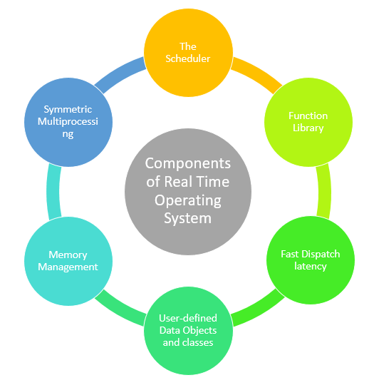
Components of RTOS

Slide 7
Types of RTOS
Three types of RTOS systems are:
Hard Real Time :
In Hard RTOS, the deadline is handled very strictly which means that given task must start executing on specified scheduled time, and must be completed within the assigned time duration.
Example: Medical critical care system, Aircraft systems, etc.
Firm Real time:
These type of RTOS also need to follow the deadlines. However, missing a deadline may not have big impact but could cause undesired affects, like a huge reduction in quality of a product.
Example: Various types of Multimedia applications.
Soft Real Time:
Soft Real time RTOS, accepts some delays by the Operating system. In this type of RTOS, there is a deadline assigned for a specific job, but a delay for a small amount of time is acceptable. So, deadlines are handled softly by this type of RTOS.
Example: Online Transaction system and Livestock price quotation System.

Slide 8
Features of RTOS
Here are important features of RTOS:
Occupy very less memory
Consume fewer resources
Response times are highly predictable
Unpredictable environment
The Kernel saves the state of the interrupted task ad then determines which task it should run next.
The Kernel restores the state of the task and passes control of the CPU for that task.

Slide 9
Factors for selecting in RTOS
Here, are essential factors that you need to consider for selecting RTOS:
Performance: Performance is the most important factor required to be considered while selecting for a RTOS.
Middleware: if there is no middleware support in Real time operating system, then the issue of time-taken integration of processes occurs.
Error-free: RTOS systems are error-free. Therefore, there is no chance of getting an error while performing the task.
Embedded system usage: Programs of RTOS are of small size. So we widely use RTOS for embedded systems.
Maximum Consumption: we can achieve maximum Consumption with the help of RTOS.
Task shifting: Shifting time of the tasks is very less.
Unique features: A good RTS should be capable, and it has some extra features like how it operates to execute a command, efficient protection of the memory of the system, etc.
24/7 performance: RTOS is ideal for those applications which require to run 24/7.

Slide 10
Applications of RTOS
Real-time systems are used in:
Airlines reservation system.
Air traffic control system.
Systems that provide immediate updating.
Used in any system that provides up to date and minute information on stock prices.
Defense application systems like RADAR.
Networked Multimedia Systems
Command Control Systems
Internet Telephony
Anti-lock Brake Systems
Heart Pacemaker

Slide 11
advantages of RTOS
Maximum consumption – Maximum utilization of devices and system. Thus more output from all the resources.
Task Shifting – Time assigned for shifting tasks in these systems are very less. For example in older systems it takes about 10 micro seconds. In shifting one task to another and in latest systems it takes 3 micro seconds.
Focus On Application – Focus on running applications and less importance to applications which are in queue.
Real Time Operating System In Embedded System – Since size of programs are small, RTOS can also be embedded systems like in transport and others.
Error Free – These types of systems are error free
Memory Allocation – Memory allocation is best managed in these type of systems.

Slide 12
Disadvantages of RTOS
Limited Tasks – Very few task run at the same time and their concentration is very less on few applications to avoid errors.
Use Heavy System Resources – Sometimes the system resources are not so good and they are expensive as well.
Complex Algorithms – The algorithms are very complex and difficult for the designer to write on.
Device Driver And Interrupt signals – It needs specific device drivers and interrupt signals to response earliest to interrupts.
Thread Priority – It is not good to set thread priority as these systems are very less pron to switching tasks.

Slide 13
Thank You
Have a Good Day!

